Slide 1
Investigating the Characteristics of Carsharing Usage Pattern for Public Rental Housing Complexes
Dong-Joon Woo
(Seoul National Univ.)
Research Summary
Category | Description
Objectives | Identify the characteristics of rental housing complexes influencing vehicle usage rate Investigate the attributes of the HappyCar
Data for Analysis | Survey data from carsharing members Operation record log files provided from a service operator
Methodology | Performance Analysis (IPA) technique → To analyze which attributes of the HappyCar requires improvement Beta regression model → To identify factors affecting vehicle usage rate
Findings | The possibility for the carsharing service to be an alternative transportation mode that can secure the mobility of a marginalized neighborhood was confirmed This study can help in determining the most appropriate supply sizes of the HappyCar service for each complex by considering the characteristics of rental housing complexes.

Slide 2
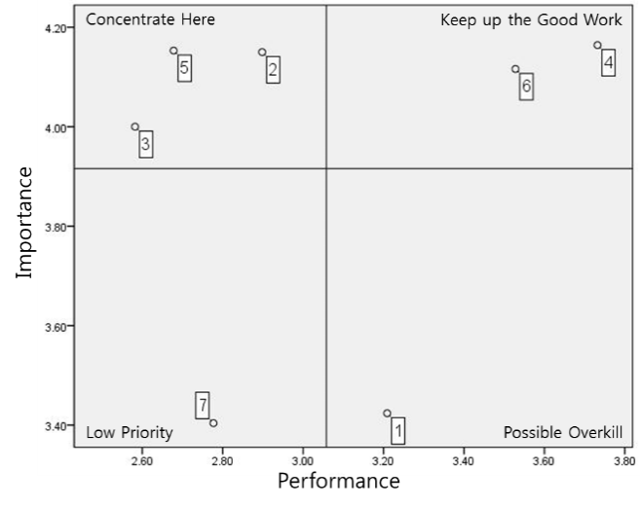
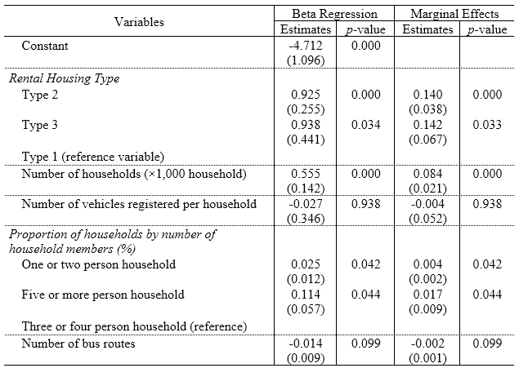
Research Summary
IPA Results
  Increase in the number of vehicles for the HappyCar service fall into the Quadrant 1(Figure 3), indicating these attributes should be addressed and improved upon as soon as possible.
  Showed that three attributes including appropriateness of rental rates, thorough vehicle maintenance, and increase in the number of vehicles operated should be improved in order to make the HappyCar service more convenient and comfort.
Results of Beta Regression Model
  Usage rate in Type 2 and Type 3 was higher than Type 1, where the lowest-income households reside.
  Housing complex with a higher number of households had a higher vehicle usage rate.
  Usage rate increased as the component ratio of 3 or 4 person households in a complex was higher than the component ratio of 1 or 2 person households.

